Slide 1
Lecture 6
Exception Handling

Slide 2
Exception:
An exception is an event, which occurs during the execution of a program, that disrupts the normal flow of the program's instructions.
The Java uses exceptions to handle errors and other exceptional events.

Slide 3
Throwing an Exception:
When an error occurs within a method, the method creates an object (exception object) and hands it off to the runtime system.
exception object, contains information about the error, including its type and the state of the program when the error occurred.
Creating an exception object and handing it to the runtime system is called throwing an exception.

Slide 4
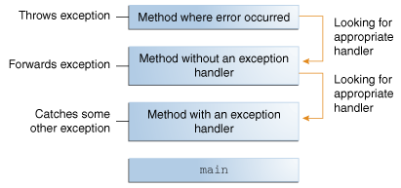
The runtime system searches the call stack for a method that contains a block of code that can handle the exception.
This block of code is called an exception handler.
The exception handler chosen is said to catch the exception.

Slide 5
Hierarchy of Java Exception classes
The java.lang.Throwable class is the root class of Java Exception hierarchy which is inherited by two subclasses: Exception and Error.

Slide 6
Types of Java Exceptions
There are mainly two types of exceptions: checked and unchecked. Here, an error is considered as the unchecked exception.
According to Oracle, there are three types of exceptions:
Checked Exception
Unchecked Exception
Error

Slide 7
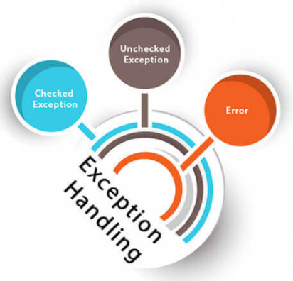

Slide 8
Difference between Checked and Unchecked Exceptions
Checked Exception
The classes which directly inherit Throwable class except RuntimeException and Error are known as checked exceptions e.g. IOException, SQLException etc. Checked exceptions are checked at compile-time.
2) Unchecked Exception
The classes which inherit RuntimeException are known as unchecked exceptions e.g. ArithmeticException, NullPointerException, ArrayIndexOutOfBoundsException etc. Unchecked exceptions are not checked at compile-time, but they are checked at runtime.
3) Error
Error is irrecoverable e.g. OutOfMemoryError, VirtualMachineError, AssertionError etc.

Slide 9
Common Scenarios of Java Exceptions
There are given some scenarios where unchecked exceptions may occur. They are as follows:
A scenario where ArithmeticException occurs
If we divide any number by zero, there occurs an ArithmeticException.
int a=50/0;//ArithmeticException
2) A scenario where NullPointerException occurs
If we have a null value in any variable, performing any operation on the variable throws a NullPointerException.
String s=null;
System.out.println(s.length());//NullPointerException

Slide 10
3) A scenario where NumberFormatException occurs
The wrong formatting of any value may occur NumberFormatException. Suppose I have a string variable that has characters, converting this variable into digit will occur NumberFormatException.
String s="abc";
int i=Integer.parseInt(s);//NumberFormatException
4) A scenario where ArrayIndexOutOfBoundsException occurs
If you are inserting any value in the wrong index, it would result in ArrayIndexOutOfBoundsException as shown below:
int a[]=new int[5];
a[10]=50; //ArrayIndexOutOfBoundsException

Slide 11
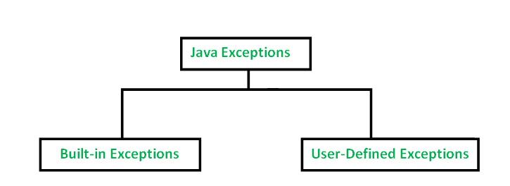
Types of Exceptions:

Slide 12
Built in exceptions
ArithmeticException It is thrown when an exceptional condition has occurred in an arithmetic operation.
ArrayIndexOutOfBoundException It is thrown to indicate that an array has been accessed with an illegal index. The index is either negative or greater than or equal to the size of the array.
ClassNotFoundException This Exception is raised when we try to access a class whose definition is not found
FileNotFoundException This Exception is raised when a file is not accessible or does not open.
IOException It is thrown when an input-output operation failed or interrupted
InterruptedException It is thrown when a thread is waiting , sleeping , or doing some processing , and it is interrupted.
NoSuchFieldException It is thrown when a class does not contain the field (or variable) specified
NoSuchMethodException It is thrown when accessing a method which is not found.

Slide 13
NullPointerException This exception is raised when referring to the members of a null object. Null represents nothing
NumberFormatException This exception is raised when a method could not convert a string into a numeric format.
RuntimeException This represents any exception which occurs during runtime.
StringIndexOutOfBoundsException It is thrown by String class methods to indicate that an index is either negative than the size of the string

Slide 14
The Catch or Specify Requirement:
This means that code that might throw certain exceptions must be enclosed by either of the following:
1. A try statement that catches the exception.
2. A method that specifies that it can throw the exception.
(The method must provide a throws clause that lists the exception.)

Slide 15
Catching Exception:
A method catches an exception using a combination of the try and catch keywords.
A try/catch block is placed around the code that might generate an exception.
Code within a try/catch block is referred to as protected code
try
{
//Protected code
}catch(ExceptionName e1)
{
//Catch block
}

Slide 16
Multiple Catch Blocks:
A try block can be followed by multiple catch blocks.
try{
// protected code
}
catch (ExceptionName1 e1){
}
catch (ExceptionName2 e2){
}
catch (ExceptionName3 e3){
}
e1
e2
e3

Slide 17
finally clause:
finally {
// this block always executes
}
The finally keyword is used to create a block of code that follows a try block.
A finally block of code always executes, whether or not an exception has occurred.

Slide 18
Throws/throw:
public void doAddition() throws MyException {
throw new MyException();
}
If a method does not handle a checked exception, the method must declare it using the throws keyword.
The throws keyword appears at the end of a method's signature.
You can throw an exception by using the throw keyword.

Slide 19
import java.io.*;
class ThrowExample {
void myMethod(int num)throws IOException, ClassNotFoundException{
if(num==1)
throw new IOException("IOException Occurred");
else
throw new ClassNotFoundException("ClassNotFoundException");
}
}
public class Example1{
public static void main(String args[]){
try{
ThrowExample obj=new ThrowExample();
obj.myMethod(1);
}catch(Exception ex){
System.out.println(ex);
}
}
}

Slide 20
Declaring your own Exception Class:
You can create your own exceptions in Java.
Note:
All exceptions must be a child of Throwable.
If you want to write a checked exception that is automatically enforced by the Handle or Declare Rule, you need to extend the Exception class.
If you want to write a runtime exception, you need to extend the RuntimeException class.
Public class MyException extends Exception {
}

Slide 21
// File Name InsufficientFundsException.java import java.io.*; public class InsufficientFundsException extends Exception { private double amount; public InsufficientFundsException(double amount) { this.amount = amount; } public double getAmount() { return amount; } }

Slide 22
// File Name CheckingAccount.java import java.io.*; public class CheckingAccount { private double balance; private int number; public CheckingAccount(int number) { this.number = number; } public void deposit(double amount) { balance += amount; } public void withdraw(double amount) throws InsufficientFundsException { if(amount <= balance) { balance -= amount; } else { double needs = amount - balance; throw new InsufficientFundsException(needs); } } public double getBalance() { return balance; } public int getNumber() { return number; } }

Slide 23
// File Name BankDemo.java public class BankDemo { public static void main(String [] args) { CheckingAccount c = new CheckingAccount(101); System.out.println("Depositing $500..."); c.deposit(500.00); try { System.out.println("\nWithdrawing $100..."); c.withdraw(100.00); System.out.println("\nWithdrawing $600..."); c.withdraw(600.00); }catch(InsufficientFundsException e) { System.out.println("Sorry, but you are short $" + e.getAmount()); e.printStackTrace(); } } }

Slide 24
Examples

Slide 25
public class ExceptionTest{
public static void main(String args[]){
int a[] = new int[2];
try{
System.out.println("Accessing element three :" + a[3]);
} catch(ArrayIndexOutOfBoundsException e){
System.out.println("Exception thrown :" + e);
}
finally{
a[0] = 6;
System.out.println("First element value: " +a[0]);
System.out.println("The finally statement is executed");
}
}
}

Slide 26
Answer:
Exception thrown :java.lang.ArrayIndexOutOfBoundsException: 3
First element value: 6
The finally statement is executed

Slide 27
Question: Is the following code legal?
try {
} finally {
}

Slide 28
Question: What exception types can be caught by the following handler?
catch (Exception e) {
}

Slide 29
Question: Is there anything wrong with this exception handler as written? Will this code compile?
try {
} catch (Exception e) {
} catch (ArithmeticException a) {
}

Slide 30
Question: Match each situation in the first list with an item in the second list.
a.
int[] A;
A[0] = 0;
b.
The JVM starts running your program, but the JVM can't find the Java platform classes. (The Java platform classes reside in classes.zip or rt.jar.)
c.
A program is reading a stream and reaches the end of stream marker.
d.
Before closing the stream and after reaching the end of stream marker, a program tries to read the stream again.
__error
__checked exception
__compile error
__no exception

Slide 31
Thank You

